Slide 1
Unconstrained Ear Recognition through State-of-the-Art Machine Learning Models: A Survey
Marwin B. Alejo
2020-20221
Disclaimer: Due to time and computing resource constraints, this topic yielded and presented only the preliminary results. Further executions are still needed for this to be a perfect paper and realized for journal publications or presentations.

Slide 2

Biometric Recognition and the Ears
Advantages of Ear for Biometrics
Ear does not change until the age of 60.
Color distribution is more uniform in ear than in face, iris, retina.
Ear images are smaller than face images, thus more efficient when computed.
Ear images are not normally affected by facial accessories except for hair and earrings.

Slide 3
Selected Notable Works in Ear Biometrics
Most papers utilize image processing and statistical techniques in realizing ear biometrics:
Canny edge algorithm, PCA, genetic algorithm
Recent paper suggested the use of ML and CNN due to its advantage over traditional computing methods:
Deep unsupervised learning with GAN
SSD-MobileNet
Deep Convolutional Neural Network and handcrafted NN
Transfer Learning of pre-trained SOTA CNN models
However, no existing study that present ear biometric solutions that utilizes SOTA Transformer-based and Transformer-inspired networks.
An open-opportunity.

Slide 4
Objectives
This study aim to:
Explore ear biometrics on SOTA Transformer-based and Transformer-inspired networks such as ViT, DeiT, CaiT, ConViT, CrossViT, PiT, XCiT, Swin Transformer, ResMLP, and MLP-Mixer.
Determine the performance of these models in terms of their recognition accuracy and memory utilization on ear biometrics task.
Provided a straightforward deep learning pipeline for ear recognition through Transfer Learning.
Compare the performance of these models with each other and the selected SOTA CNN models – ResNets and ResNeXt.
Note: Everyone are encouraged to read the original paper of these models to fully understand their novel features among each other.

Slide 5
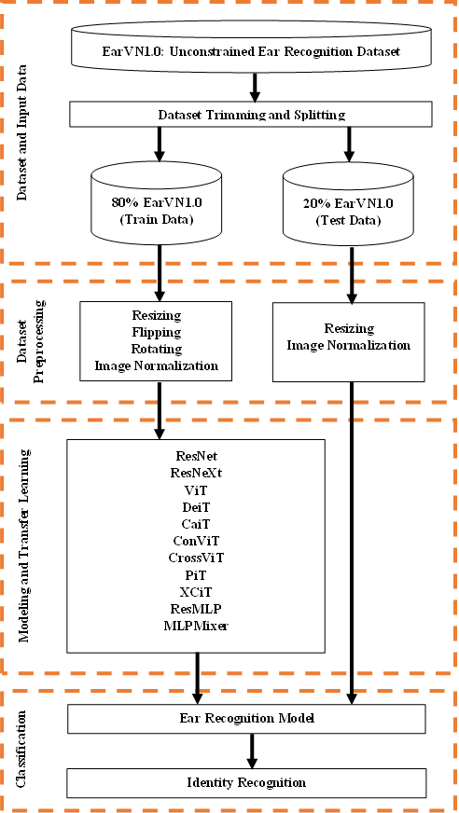
Deep Learning Pipeline
Google Colab GPU
PyTorch
PyTorch Image Models (TIMM)

Slide 6
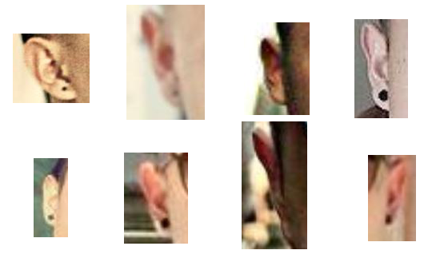
Deep Learning Pipeline
EarVN1.0
World’s largest collection of er images.
164 individuals with each having 180 images
28412 ear images.
Data Trimming and Splitting
Trimmed to 20 individuals
Total of 4000 ear images
80% Training dataset
20% Testing dataset

Slide 7
Deep Learning Pipeline
Preprocessing
3200 ear images undergone augmentation
Resizing
Flipping
Rotation by 30 degrees
Normalize using the standard ImageNet normalization values
800 ear images undergone
Resizing
Image Normalization (ImageNet standard)

Slide 8
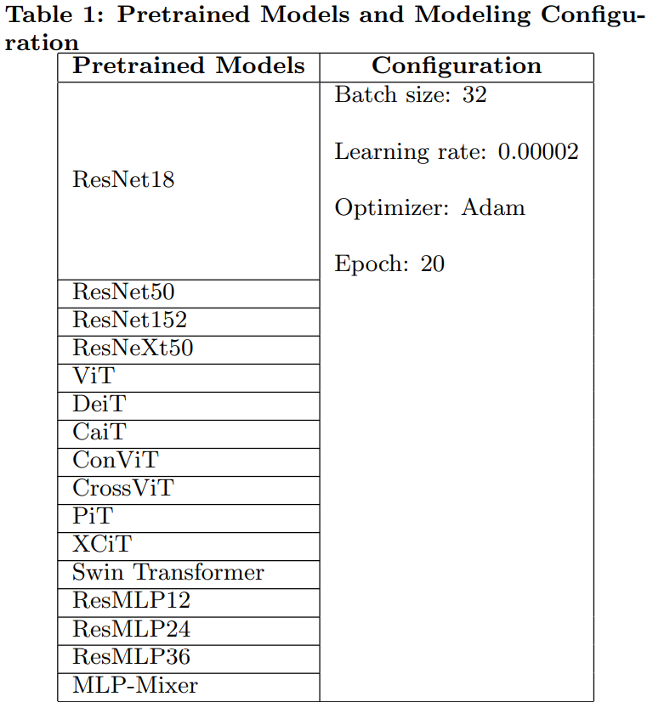
Deep Learning Pipeline

Slide 9
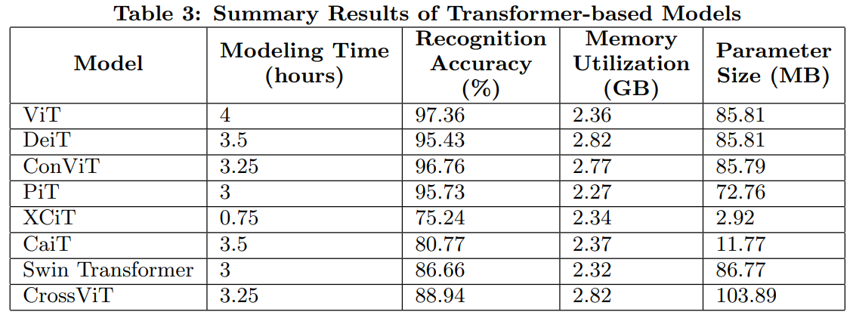
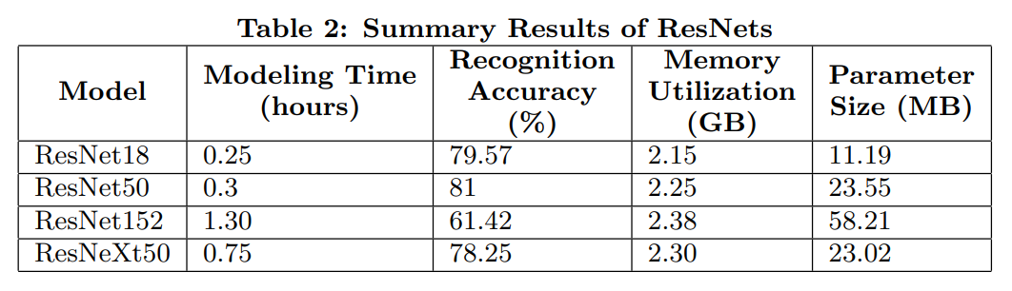
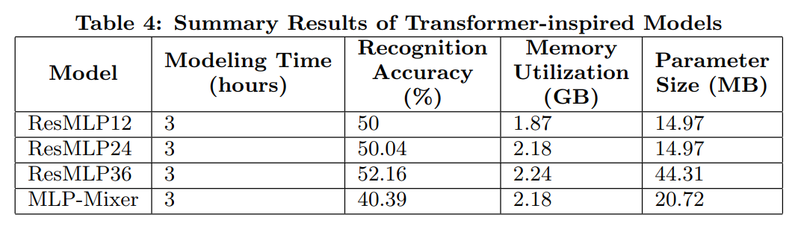
Deep Learning Pipeline

Slide 10
Generalization
On the given configurations, ResNet50 performed optimally for ear biometrics.
As ResNets become deeper, it suffers from degeneralization.
ViT performed better than its variants regardless of modeling time and utilized memory.
ConViT performed approximately on par with ViT.
Despite the performance of ResMLP and MLP-Mixer with ImageNet, it suffers greatly with ear biometrics.
Due to the low statistics of the used dataset despite transfer learning.
Due to the lack of data augmentation processes.
Overall, Transformers perform better generalization for ear biometrics over CNN and MLP.

Slide 11
Conclusion
This study explored the Ear Biometrics on selected SOTA Transformer-based and Transformer-inspired models and compared each other and on CNN-based models.
Determined that Transformer-inspired models like ResMLP and MLP-Mixer performed lesser on Ear Biometrics over Transformer-based models, specially ViT.
Provided a deep learning pipeline with Transfer Learning in its core.
Compared the performance of these models with each other and on CNN-based models and also determined that Transformer still outperform ResNets/ResNeXt.
For future, consider ConvNeXt for ear biometrics.

Slide 12
End-of-Presentation
For inquiries:
mbalejo.cpe@gmail.com (default)
marwin.alejo@eee.upd.edu.ph
mbalejo1@up.edu.ph
Codes and other materials are in my Github:
https://github.com/mbalejo/CS284/tree/main/MiniProject

